Slide 1
Part 1: Systematic uncertainties Part 2: TALYS calculations
NSCL/MSU workshop Dec 1 – 4
Day 4 – Dec 4, 2015
Ann-Cecilie Larsen

Slide 2
Outline – part 1
Systematic uncertainties
Lower/upper limits – spin distribution
Neutron resonance parameters - systematics
Giant Dipole Resonance data as a constraint?
Github: https://github.com/oslocyclotronlab/MSU_workshop_2015

Slide 3
1. Systematic errors, Oslo method
Unfolding – efficiency
Test: Correcting twice for the efficiency
DICEBOX simulated data; artificial ⁵⁷Fe nucleus
[A.C. Larsen et al., PRC 83, 034315 (2011)]

Slide 4
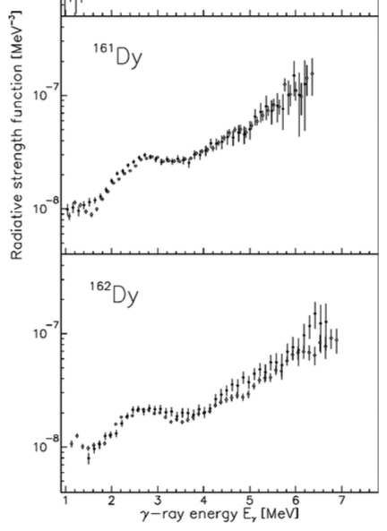
1. Systematic errors, Oslo method
Dependence on reaction mechanism
Test: Populating same nucleus through different reactions
Open: (³He,³He’)
Filled: (³He,α)
[A.C. Larsen et al., PRL 111, 242504 (2013)]
[M. Guttormsen et al., PRC 68, 064306 (2003)]

Slide 5
1. Systematic errors, Oslo method
Dependence on reaction mechanism
Test: Populating same nucleus through different reactions
[S.N. Liddick et al., beta-Oslo + OCL data]

Slide 6
1. Systematic errors, Oslo method
Main assumption of f.g. method not fulfilled?
Different population of states in the direct reaction vs. γ-decay feeding from above
7⁺ level @ E_{x} = 910 keV
[A.C. Larsen et al., PRC 83, 034315 (2011); PRC 73, 064301 (2006)]

Slide 7
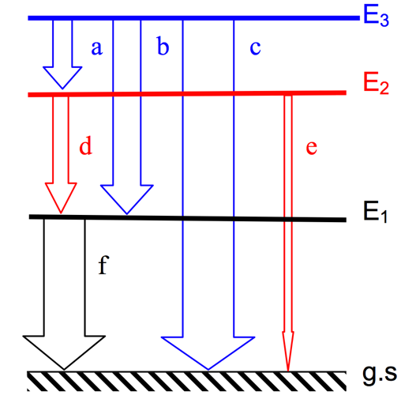
1. Systematic errors, Oslo method
Different detector resolution for E_{x} and E_{γ}
“Miss” part of the weighting function if δ(E_{γ}) > δ(E_{x})?
Can have ≈5% leftovers
of higher generations
[A.C. Larsen et al., PRC 83, 034315 (2011)]

Slide 8
1. Systematic errors, Oslo method
More realistic tests with DICEBOX
Artificial ⁵⁷Fe
[A.C. Larsen et al., PRC 83, 034315 (2011)]

Slide 9
1. Systematic errors, Oslo method
More realistic tests with DICEBOX
Artificial ⁵⁷Fe
Can have ≈5% leftovers
of higher generations
[A.C. Larsen et al., PRC 83, 034315 (2011)]

Slide 10
1. Systematic errors, Oslo method
The Brink hypothesis
DICEBOX simulations, artificial ¹⁶³Dy
[A.C. Larsen et al., PRC 83, 034315 (2011)]
[H.T. Nyhus et al., PRC 81, 024325 (2010)]

Slide 11
1. Systematic errors, Oslo method
Parity distribution
[D. Mocelj et al., PRC 75, 045805 (2007); U. Agvaanluvsan et al., PRC 67, 064608 (2003)]

Slide 12
1. Systematic errors, Oslo method
Parity distribution
[S. Goriely et al., PRC 78, 064307 (2008); A.C. Larsen et al., PRC 83, 034315 (2011)]

Slide 13
1. Systematic errors, Oslo method
Parity distribution
[A.C. Larsen et al., PRC 83, 034315 (2011)]

Slide 14
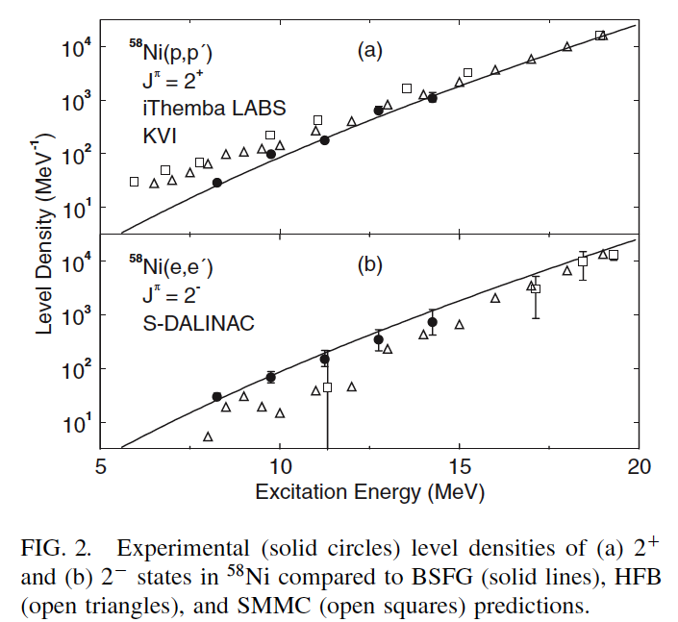
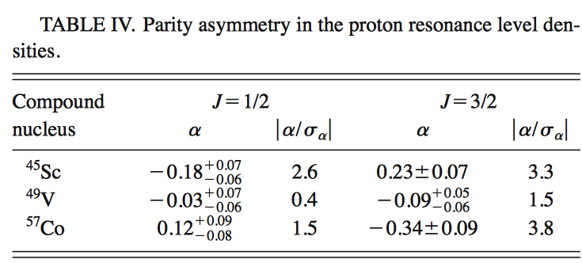
1. Systematic errors, Oslo method
Parity distribution – experiments
[U. Agvaanluvsan et al., PRC 67, 064608 (2003)]
[Y. Kalmykov et al., PRL 99, 202502 (2007)]

Slide 15
2. Lower/upper limits
Spin distribution
[von Egidy et al., NP A481, 189 (1988)]
[von Egidy and Bucurescu, PRC 72, 044311 (2005)]
[Demetriou and Goriely, NP A695, 95 (2001)]
[Hilaire and Goriely, NP A779, 63 (2006)]
[A.C. Larsen et al., submitted to PRC (2015)]

Slide 16
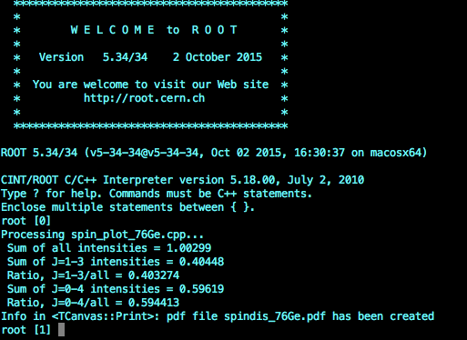
2. Lower/upper limits
Impact on the slope of the γ-transmission coefficient?
-> Can be too steep!
Adjust the slope of the transmission coeff.,
but remember to keep the full level density for the ‘normalization’ code

Slide 17
3. Neutron-resonance parameters
Systematics
[A.C. Larsen et al., submitted to PRC (2015)]
[A. Spyrou, S.N. Liddick, A.C. Larsen, M. Guttormsen
et al., Phys. Rev. Lett. 113, 232502 (2014)]
Example: folder systematics_D0_Gg @ the Github

Slide 18
3. Neutron-resonance parameters
Strategy:
Get neutron-resonance spacings from your favorite library (RIPL-3, Mughabghab’s atlas, … ) for the mass region or isotopic chain
Choose a model for the spin cutoff parameter
Calculate semi-experimental ρ(S_{n}) values
Calculate “theoretical” ρ(S_{n}) values within the model for the spin cutoff, scale with a common factor to get these values within the semi-experimental ones (if possible)
Estimate the unknown ρ(S_{n}) value by scaling the “theoretical” ρ(S_{n}) value by the same factor
[A. Spyrou, S.N. Liddick, A.C. Larsen, M. Guttormsen
et al., Phys. Rev. Lett. 113, 232502 (2014)]
⁷⁶Ge: ρ(S_{n}, EB09-min) = 47032 MeV⁻¹ -> D₀ = 315 eV
<Γ_{γ}> = 193 meV (max 295 meV from TALYS, min 147 meV)

Slide 19
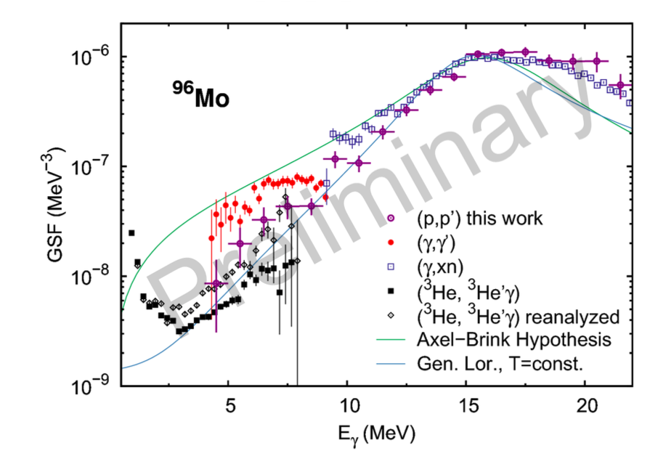
4. GDR data as a constraint
From detailed balance: f_{up} = f_{down}
Dirk Martin, TU Darmstadt (talk @ the Oslo workshop 2013)
– confirmed by Prof. Peter von Neumann-Cosel, Oct 2015
[A. Spyrou, S.N. Liddick, A.C. Larsen, M. Guttormsen
et al., Phys. Rev. Lett. 113, 232502 (2014)]

Slide 20
Outline – part 2
A very short intro to TALYS
Calculations with default models
Experiment-guided input
Github: https://github.com/oslocyclotronlab/MSU_workshop_2015

Slide 21
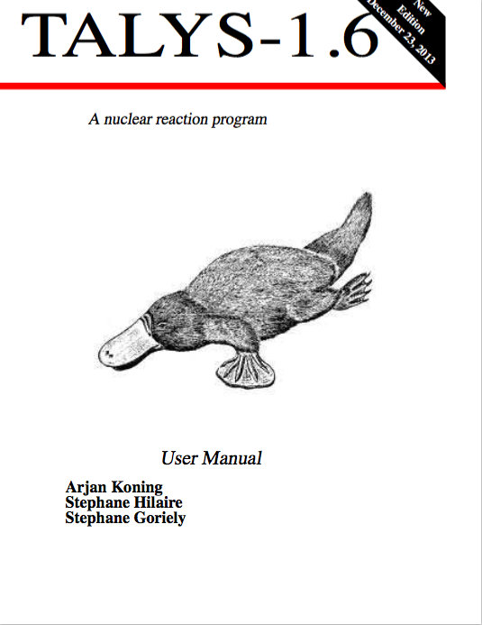
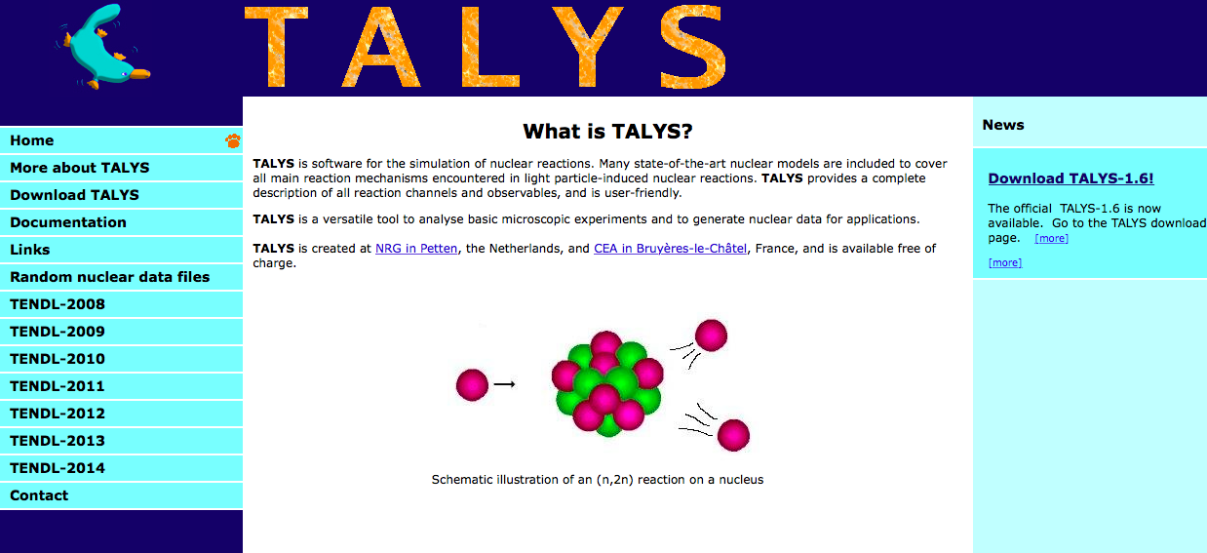
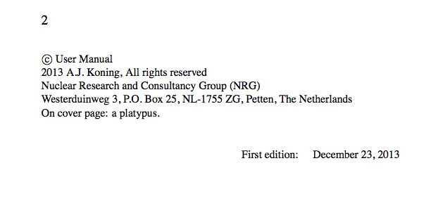
TALYS – a nuclear reaction code
http://www.talys.eu
Fortran…
A. J. Koning, S. Hilaire and M. C. Duijvestijn, ”TALYS-1.6”,
Proceedings of the International Conference on Nuclear Data for Science and Technology,
April 22-27, 2007, Nice, France, editors O. Bersillon, F. Gunsing, E. Bauge, R. Jacqmin, and S. Leray,
EDP Sciences, 2008, p. 211-214; A. J. Koning and D. Rochman, Nuclear Data Sheets 113, 2841 (2012).

Slide 22
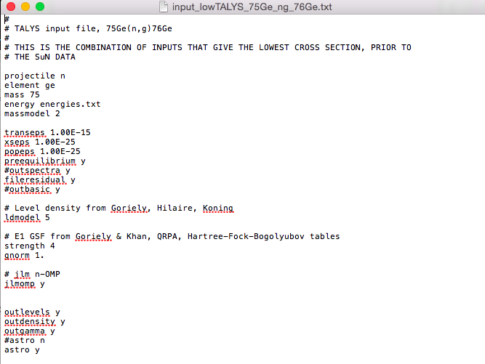
TALYS – input file, ⁷⁵Ge(n,γ)⁷⁶Ge

Slide 23
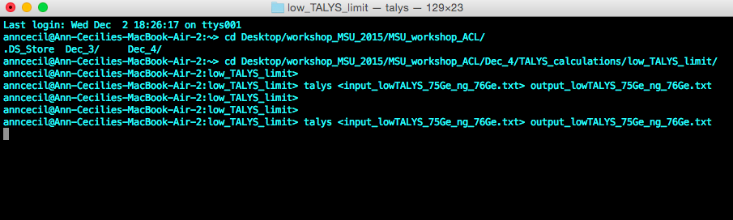
TALYS – run input file

Slide 24
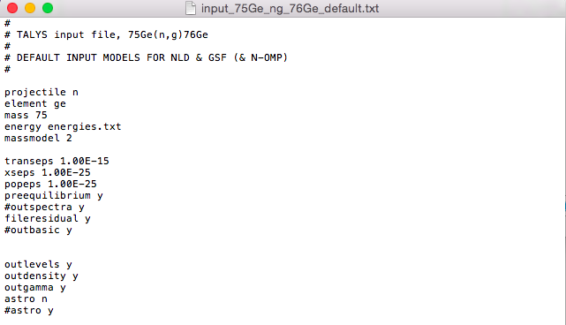
TALYS default models
(n,γ) cross section in the output file rp032076.tot, (n,γ) reaction rate (after running with ‘astro y’) in astrorate.g

Slide 25
Experiment-guided input
See also the example for yttrium in talys_Oslo_guided_input.pdf
We want:
Level density compatible with data – D₀, shape of exp. NLD
Gamma strength function also compatible with data - <Γ_{γ}>, shape of exp. γSF
-> Code ct_nld_talysform_76Ge.cpp to make the NLD in tabular format (as in ‘ldmodel 4’)
-> Change GDR parameters and/or add pygmy/scissors resonances in the input file
-> Make a proper γSF model (e.g. including the upbend) in fstrength.f (TALYS subroutine)

Slide 26
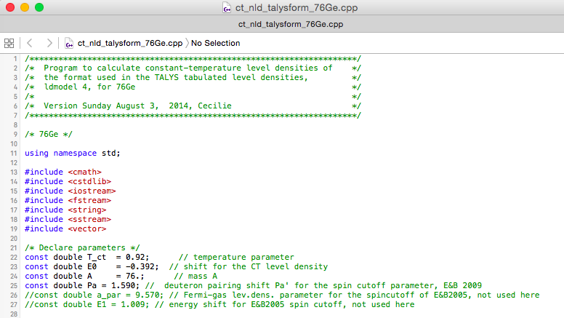
Exp.-guided input, ⁷⁶Ge details
Level density compatible with data – D₀, shape of exp. NLD
-> Code ct_nld_talysform_76Ge.cpp to make the NLD in tabular format (as in ‘ldmodel 4’)
From ‘counting’
(see ‘input.cnt’)

Slide 27
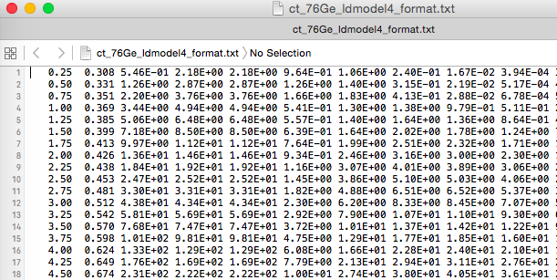
Exp.-guided input, ⁷⁶Ge details
Level density compatible with data – D₀, shape of exp. NLD
In the TALYS folder, ‘ldmodel 4’: /Applications/talys/structure/density/ground/goriely/
Duplicate z032.tab (in case you want to go back and use the original later)
Copy & paste the experiment-guided level density (up to Ex = 20 MeV or so)

Slide 28
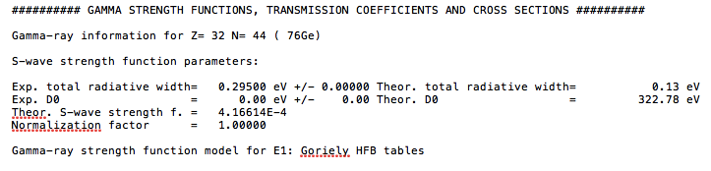
Exp.-guided input, ⁷⁶Ge details
Level density compatible with data – D₀, shape of exp. NLD
In the TALYS input file (see input_75Ge_ng_76Ge_EB09.txt), make sure that
ctable 32 76 0.
ptable 32 76 0.
These are shift & slope-adjustment parameters for the HF-BCS calculations!
(z032 in /Applications/talys/structure/density/ground/goriely/ )
Check output file from TALYS that the D0 value is reasonably well reproduced
Small differences are okay and probably due to loss of precision in the interpolation (# significant digits in the table, see previous slide)

Slide 29
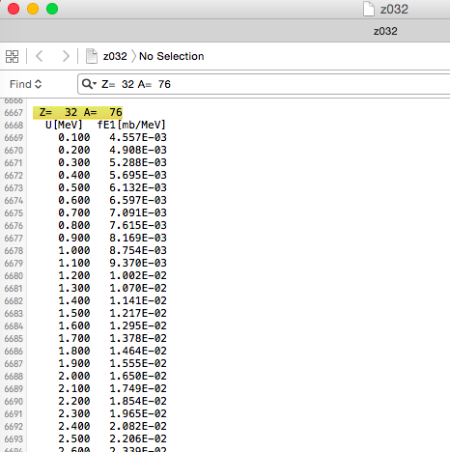
Exp.-guided input, ⁷⁶Ge details
2. Gamma strength function also compatible with data - <Γ_{γ}>, shape of exp. γSF
In the TALYS folder, ‘strength 4’: /Applications/talys/structure/gamma/hfb/

Slide 30
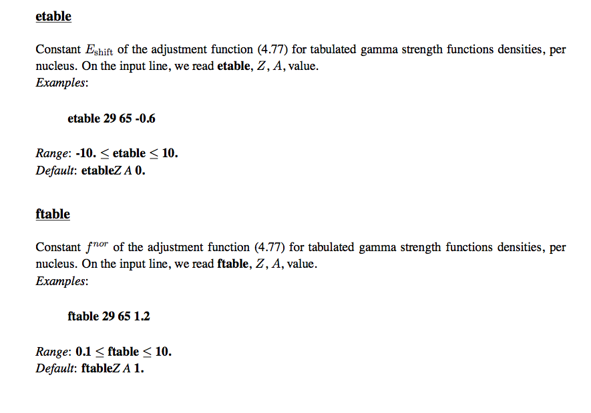
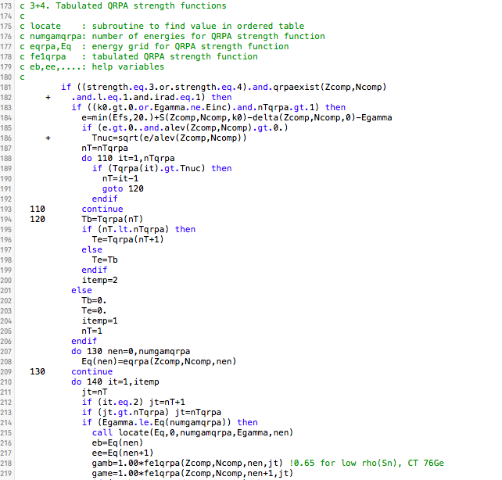
Exp.-guided input, ⁷⁶Ge details
2. Gamma strength function also compatible with data - <Γ_{γ}>, shape of exp. γSF
In the TALYS folder, ‘strength 4’: /Applications/talys/source/fstrength.f
Scaling of QRPA calculations to get the lower exp.limit
Easier: use scaling option in the input file directly:
strength 4
etable 32 76 0.
ftable 32 76 0.65
-> avoiding recompilation of TALYS

Slide 31
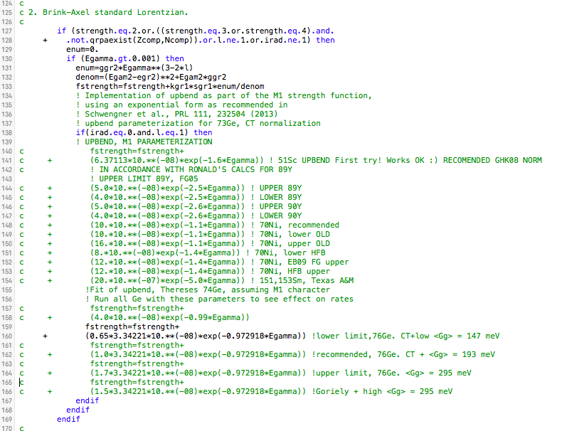
Exp.-guided input, ⁷⁶Ge details
2. Gamma strength function also compatible with data - <Γ_{γ}>, shape of exp. γSF
In the TALYS folder, ‘strength 4’: /Applications/talys/source/fstrength.f
Add upbend as M1 strength
NOTE: must recompile TALYS
In TALYS folder:
>./talys.setup

Slide 32
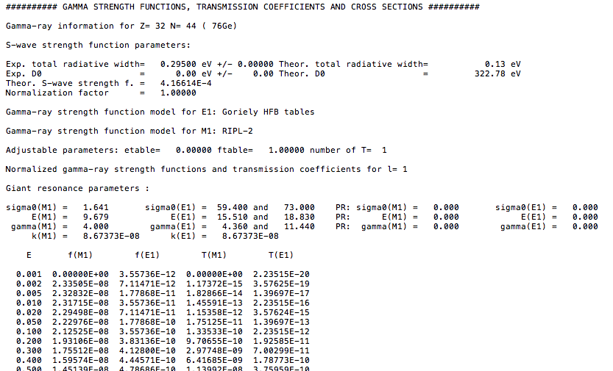
Exp.-guided input, ⁷⁶Ge details
2. Gamma strength function also compatible with data - <Γ_{γ}>, shape of exp. γSF
Run TALYS and check (remember: ‘astro n’ and ‘astro y’ to get x-section & rate):
> talys <input_75Ge_ng_76Ge_EB09.txt> output_75Ge_ng_76Ge_EB09.txt
≈13% too small, but considering the statistical error bars, well within…
Because I ran with a recompiled fstrength.f

Slide 33
Exp.-guided input, ⁷⁶Ge, low limit
In ROOT: run talys_calc_plots.cpp
Get something like this:

Slide 34


The end! [Or the beginning…]
To-do list:
Try to reduce uncertainties in the absolute normalization of the level density and gamma strength
Better understanding of the spin distribution
Nail down the electromagnetic character of the upbend
A more elegant way (!) of including experimental data in TALYS
+++

